Slide 1


Building Scalable IMS LTI Tools Using the TSUGI Framework
Charles Severance
www.dr-chuck.com
www.tsugi.org

Slide 2




Slide 3
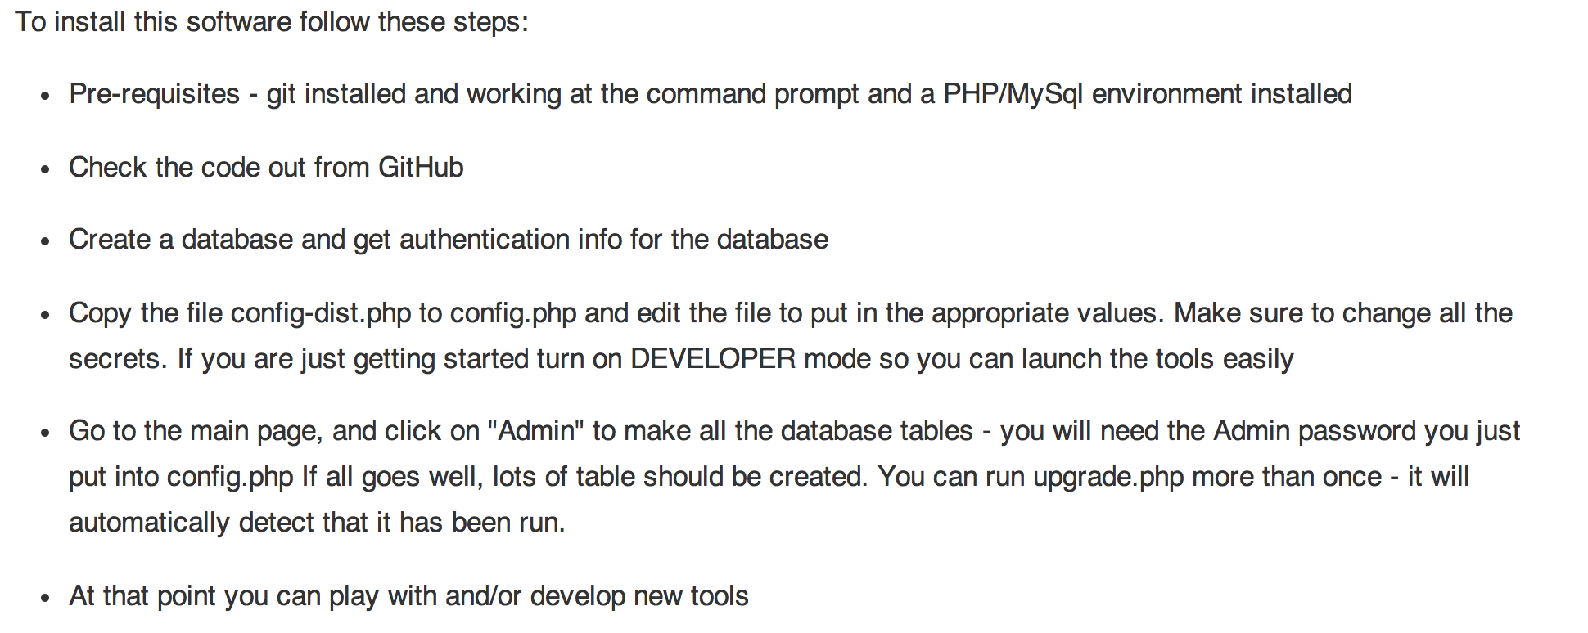
Installation Instructions
www.tsugi.org

Slide 4
Project Tsugi
Tool Hosting Container (i.e. Like a B2)
PHP now, Java in development
Based on IMS Specifications
LTI 1.x / LTI 2.x / IMS Settings / Common Cartridge / Caliper / CASA / Roster / Gradebook / ....
Tools can run on a campus hosting platform or commercial provider or cloud
Tools are "installed" into hosting containers

Slide 5
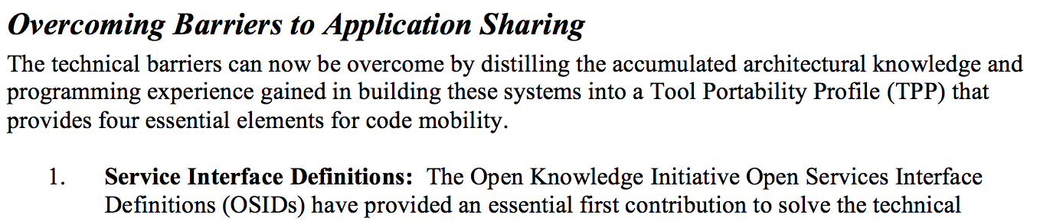
From the 2003 Sakai Proposal
http://www-personal.umich.edu/~csev/papers/2004/2004_03_01_mellon_sakai_proposal.pdf

Slide 6





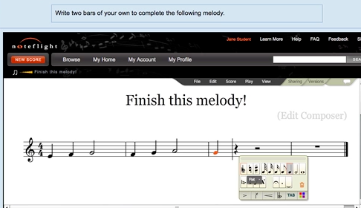




WTD?
...

Slide 7

L
T
I
PHP
Java
C#
...
But...

Slide 8






"Large Midwestern University"
Sakai
.......
Looks pretty cool.... But...

Slide 9
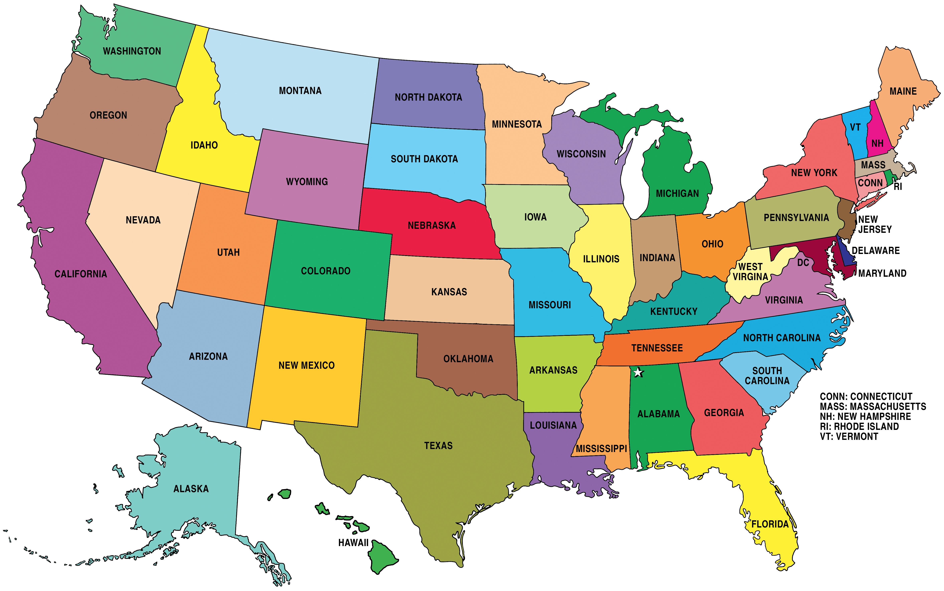
Sakai
Where is the user data??
What happens when there are 50 apps?
What if the app is free and hosted by a professor?
What happens if we stop paying the license?

Slide 10
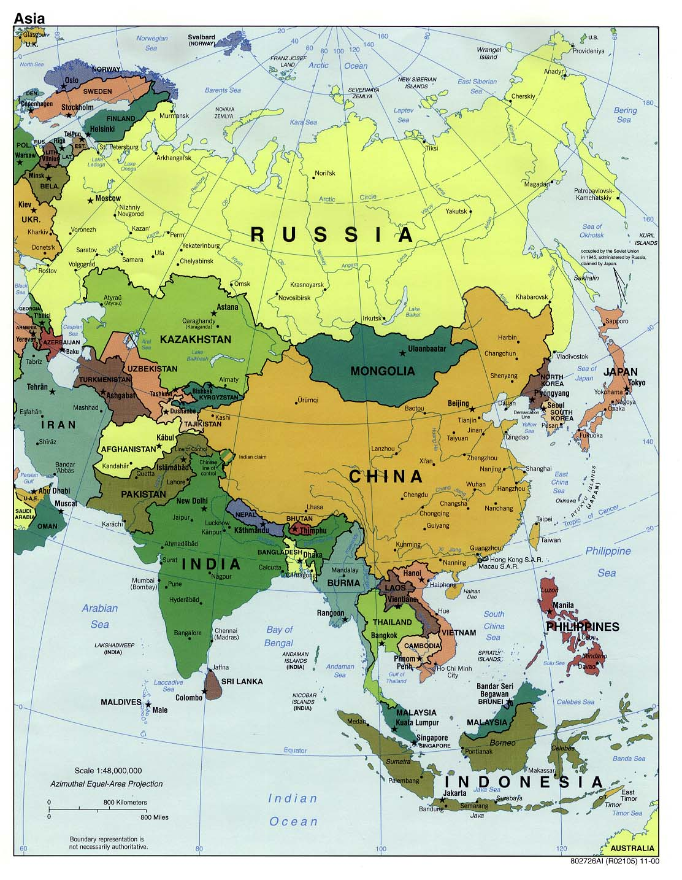
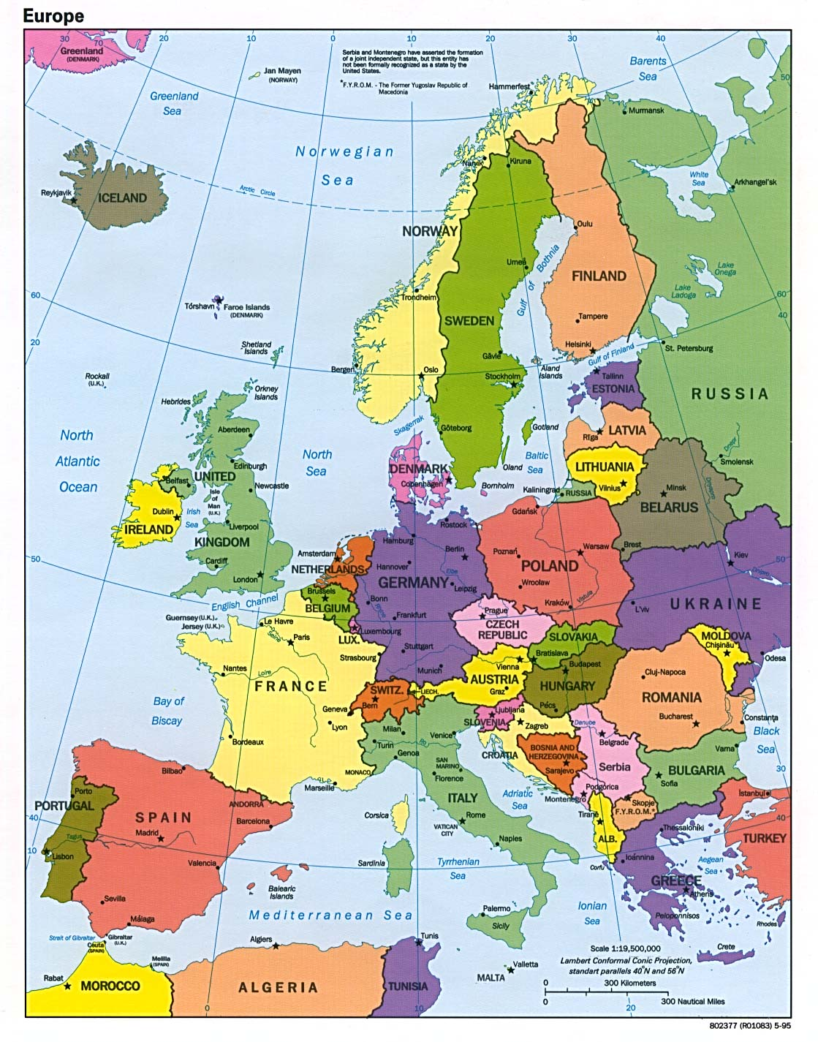
Neo-Colonialism
LTI-style

Slide 11
LTI 1.x versus LTI 2.x and Beyond
LTI 1.x – Three pages of spec and some "hello world" code
LTI 2.x – Several specs – multiple interactions
We will need to share common implementations across instructions
And what about Caliper, Casa, xAPI, etc. ??

Slide 12
Sir ,
I am doing a project on Tool providers for LTI 1.1
We are developing tools that would be compatible with both LTI 1.1 and LTI 2.0.
Can you help in developing a LTI 1.1 tool consumer and tool provider.
Please provide me with sample source codes and documentation on how to use it for LTI 1.1.
S. C.
Intern
IIT Bombay

Slide 13
Issues with Learning Tools
Cookies in iframes do not work well
Session hikacking
Session lifetime
Aligning look and feel with LMS UI
Asynchronous grading (instructor/peer)
Dealing with LMS outages
Batch processing
....

Slide 14
Can we make this easy?
Make building learning tools easy and fun
Engage students in open source and educational technology
Something that can be done in an undergraduate software development capstone

Slide 15
Project Tsugi
Tool Hosting Container (i.e. Like a B2)
PHP now, Java and Node in development
Based on IMS Specifications
LTI 1.x / LTI 2.x / IMS Settings / Common Cartridge / Caliper / CASA / Roster / Gradebook / ....
Tools can run on a campus hosting platform or commercial provider or cloud
Tools are "installed" into hosting containers

Slide 16



Multiple LMS Campus + App Store
App
Store
Tool
Tool
Tool
Tool
...

Slide 17
Multiple LMS Campus + App Store
Tsugi
Hosting
Container
Tool
Tool
Tool
Install
App
Store
Tool
Tool
Tool
Tool
...

Slide 18
Multiple LMS Campus + App Store
Tsugi
Prod
Tsugi
Exp
Tool
Tool
Tool
App
Store
Tool
Tool
Tool
Tool
...

Slide 19
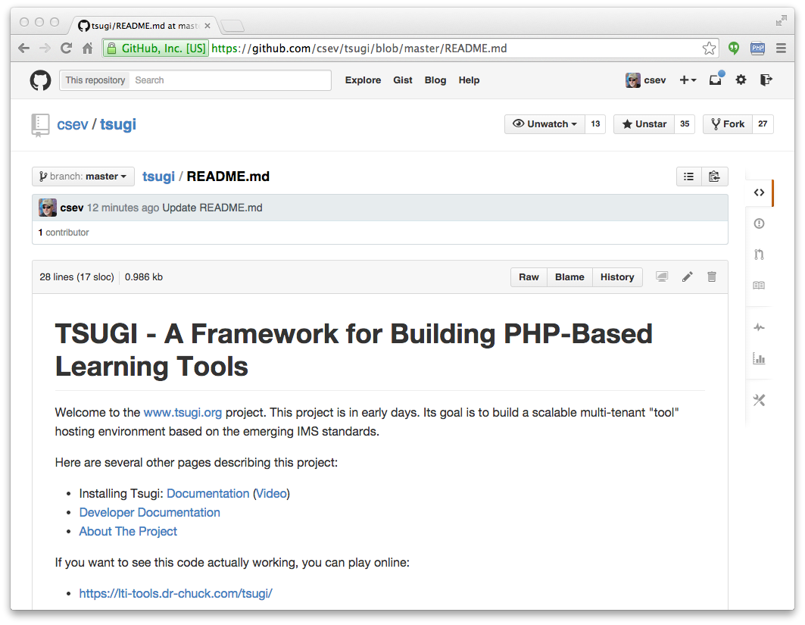
www.tsugi.org

Slide 20
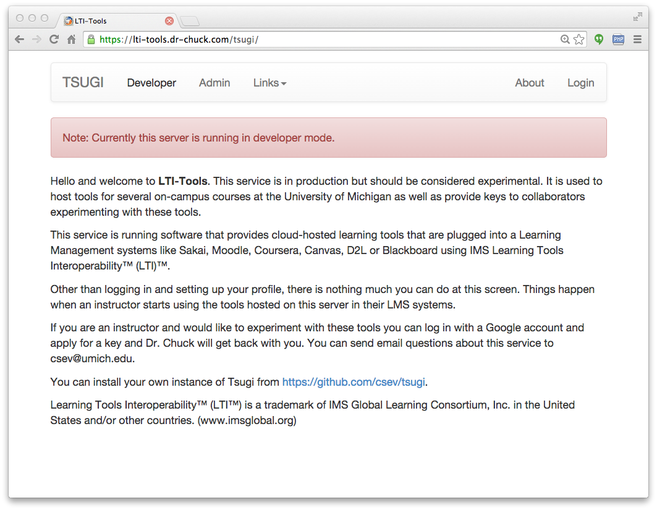

Slide 21
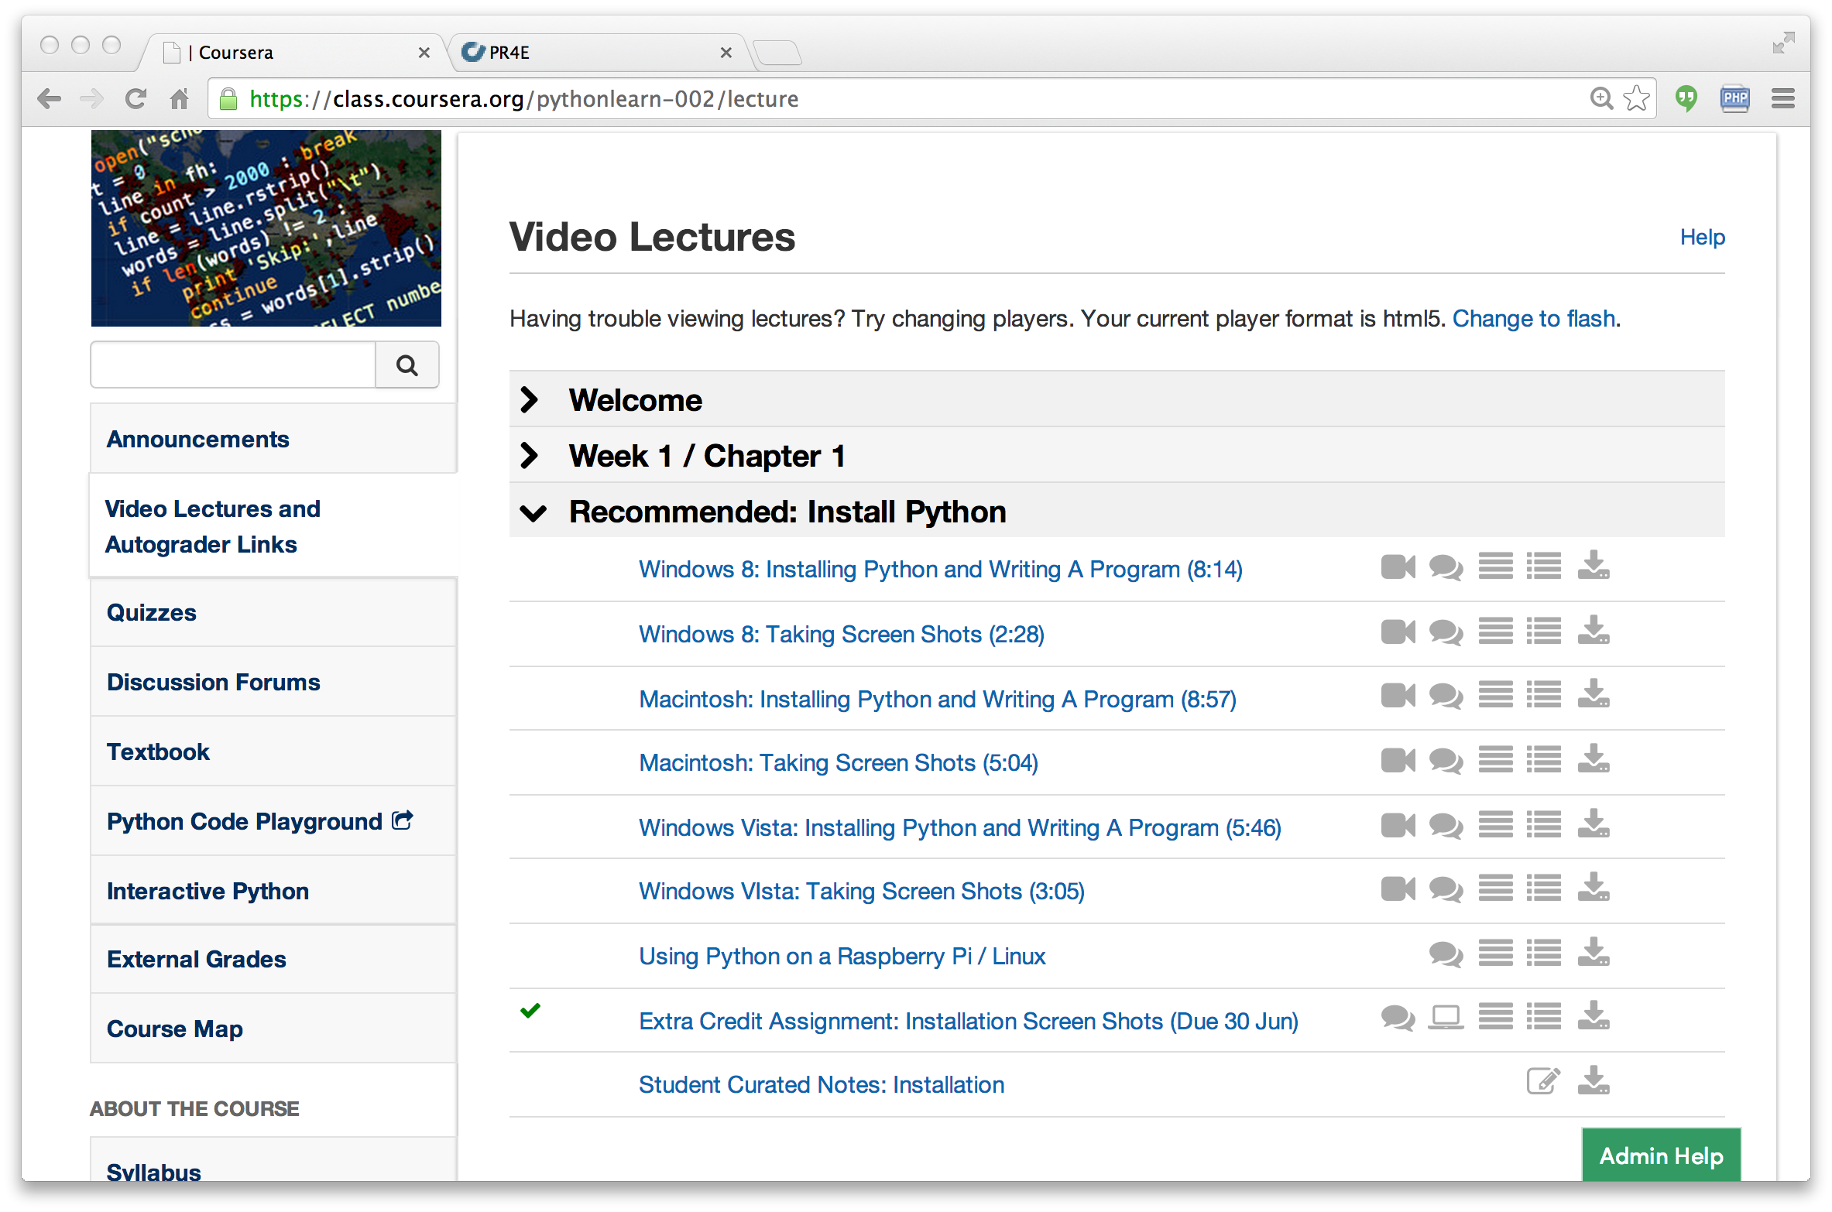

Slide 22
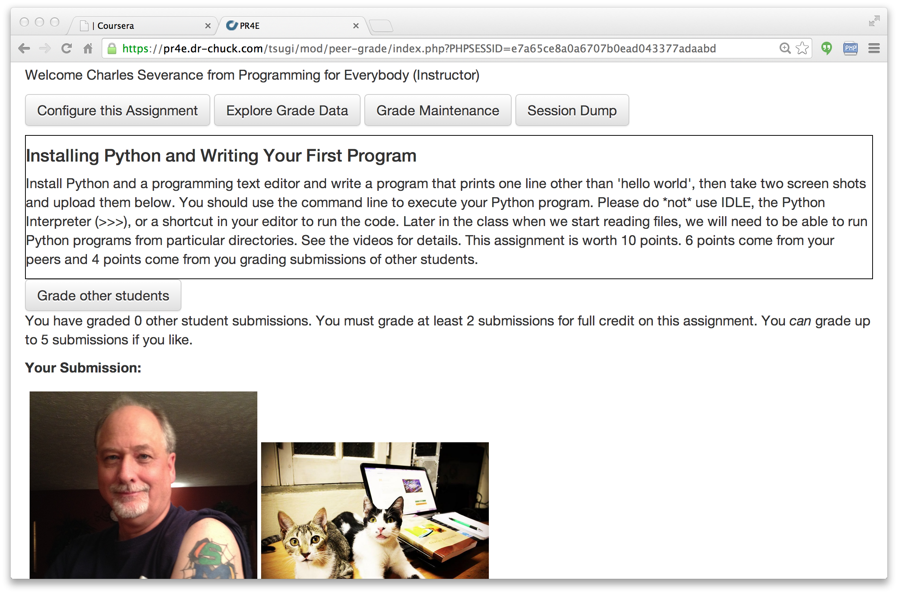

Slide 23
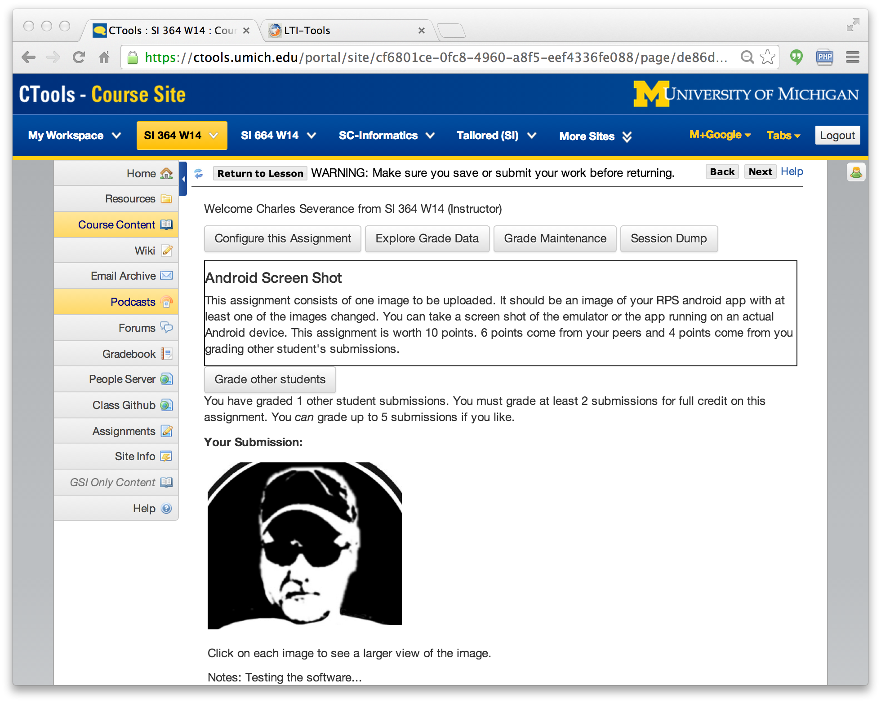

Slide 24
PHP Tsugi
Reduce the barriers to production
Easy to learn, easy to deploy (self-service)
Enable lots of small, learning-focused tools
Install / Configuration similar to Moodle
Multi-tenant
Cookie free (i.e. loves iframes)
Auto-ddl feature to upgrade schema
Recorded lectures – Perhaps a MOOC?
youtube.tsugi.org

Slide 25
Sample PHP Tsugi Tools
Google Map
Attendance Tool
GIFT Quiz
Peer-graded drop box
App Store
Sample auto graders
Python
PHP
SQL
HTML

Slide 26
PHP Tsugi Components
Admin, Developer, and Management Console
https://github.com/csev/tsugi
Core PHP Library
https://github.com/csev/tsugi-php
http://do1.dr-chuck.com/tsugi/phpdoc/namespaces/Tsugi.html
Basic Module Set
https://github.com/csev/tsugi-php-mod

Slide 27
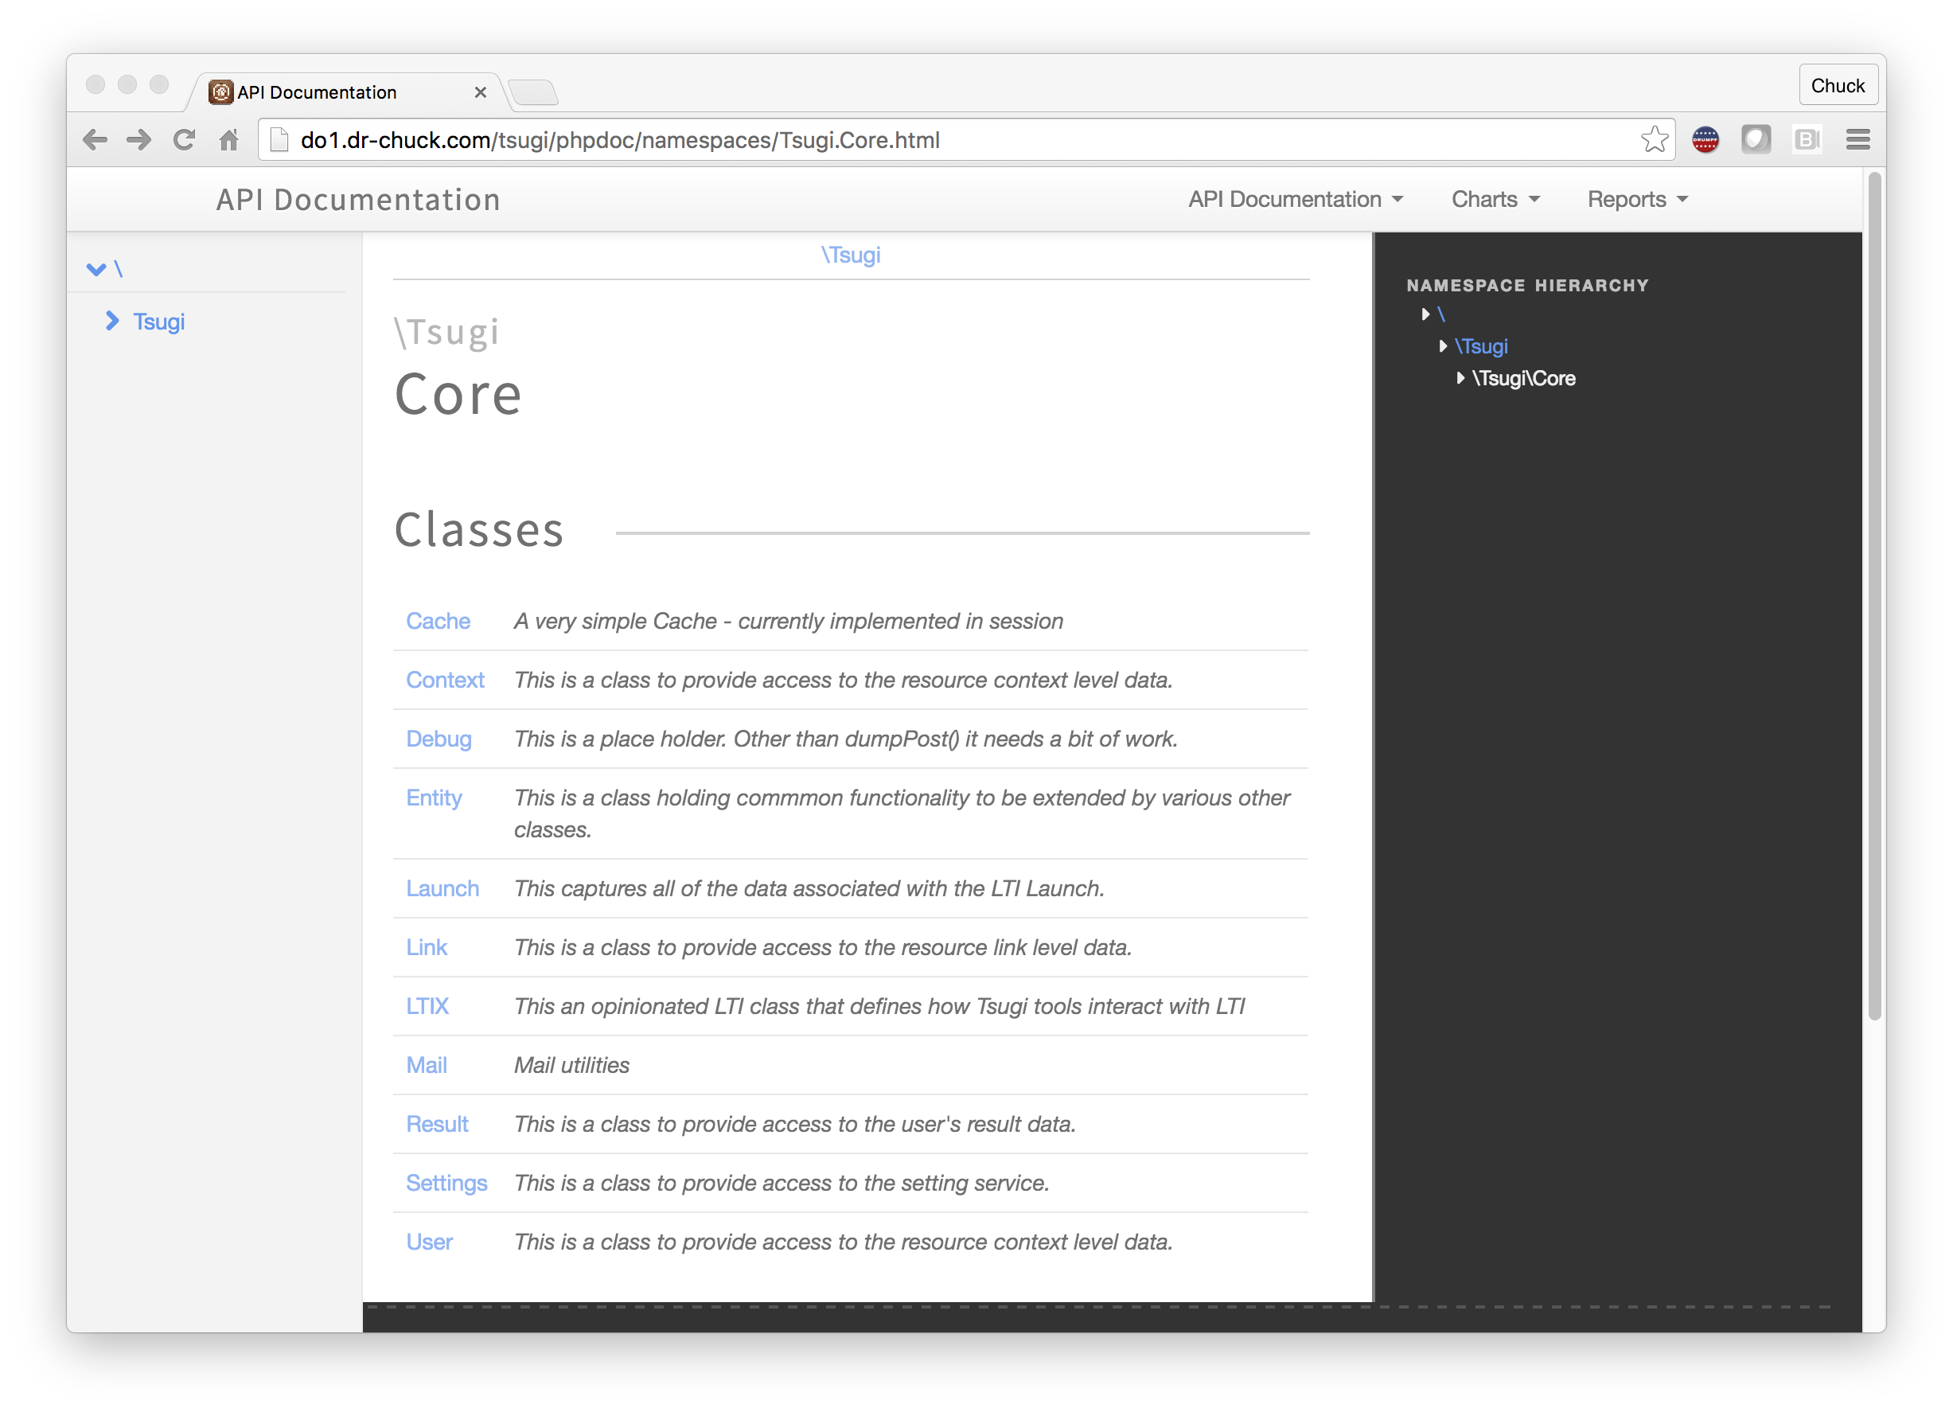

Slide 28
PHP Tsugi Components
Static content (shared / CDN)
https://github.com/csev/tsugi-static
Sample Tsugi Module
https://github.com/csev/tsugi-php-module
Sample Tsugi Standalone Application
https://github.com/csev/tsugi-php-standalone
Exercises for Course/Workshop
https://github.com/csev/tsugi-php-exercises

Slide 29
PHP Tsugi Tool Code
<?php
require_once "config.php";
use \Tsugi\Core\LTIX;
$LTI = LTIX::requireData(array('user_id',
'link_id', 'role','context_id'));
...
$OUTPUT->header();
$OUTPUT->bodyStart();
$OUTPUT->flashMessages();
$OUTPUT->welcomeUserCourse();
if ( $USER->instructor ) {
...

Slide 30
Demo
https://lti-tools.dr-chuck.com/tsugi/
Developer mode
Apply for keys

Slide 31
PHP Tsugi Next Steps
IMS LTI 2.1 Support – UI/UX
Improve Internationalization
xAPI support
IMS Caliper Support
IMS Casa Support - productionize
Outreach / training
Tsugi is in 24x7 production and I can support a few experimenters on my servers.

Slide 32
Tsugi Java
Low Level IMS API Code
https://github.com/sakaiproject/sakai/tree/master/basiclti/tsugi-util
Released in Sonatype
<groupId>org.tsugi</groupId>
<artifactId>tsugi-util</artifactId>
Java Library
https://github.com/csev/tsugi-java

Slide 33
Tsugi Java
API Documentation
http://csev.github.io/tsugi-java/apidocs/
Sample TsugiServlet / Maven / JDBC
https://github.com/csev/tsugi-java-servlet
Simple Sample Servlet / Maven / JDB
https://github.com/csev/maven-jetty-jdbc-servlet

Slide 34
Java Tsugi Tool Code
Launch launch = tsugi.getLaunch(req, res);
if ( launch.isComplete() ) return;
if ( ! launch.isValid() ) {
throw new RuntimeException(launch.getErrorMessage());
}
Output o = launch.getOutput();
Properties p = o.header(out);
out.println("<title>Sample</title>");
// Some of my CSS includes...
o.bodyStart(out);
o.navStart(out); // If you want it..
o.flashMessages(out);
out.println("<pre>");
out.println("Welcome to hello world!");
out.println("</pre>");
o.navEnd(out); // If you started it
o.footerStart(out);
// Some of my own JavaScript goodness
$(document).ready( ... );
o.footerEnd(out);

Slide 35
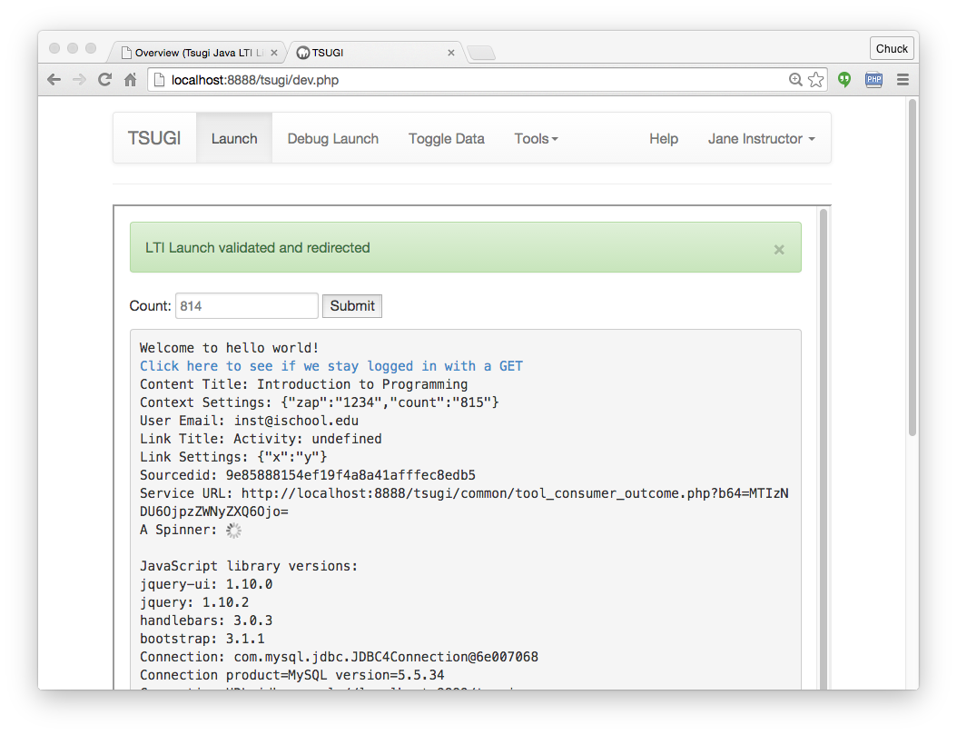

Slide 36
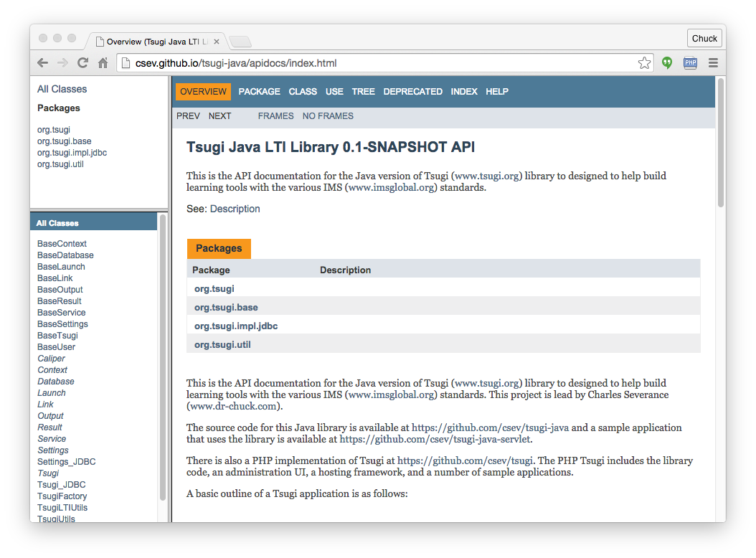

Slide 37
Deploying Java Tsugi Apps
Tomcat
Amazon
JTsugi
JTusgi
Tsugi
Tool
Tsugi
Tool
Sakai
Sakai
STsugi
Sakai
Tool
Tsugi
Tool

Slide 38
Node Tsugi
Based on Node 6.x and ES6
Handles LTI Launches
Connects to the Tsugi database and maintains launch data
Uses PHP Console
Depends on the PHP Maint/Dev/Admin Console
Expecting Alpha release Summer 2016

Slide 39
Node Tsugi
Node low-Level LTI code
https://github.com/csev/tsugi-node-lti
https://www.npmjs.com/package/tsugi-node-lti
Node Library Code
https://github.com/csev/tsugi-node
http://do1.dr-chuck.com/tsugi-node/esdoc/
Node Sample Application
https://github.com/csev/tsugi-node-sample

Slide 40
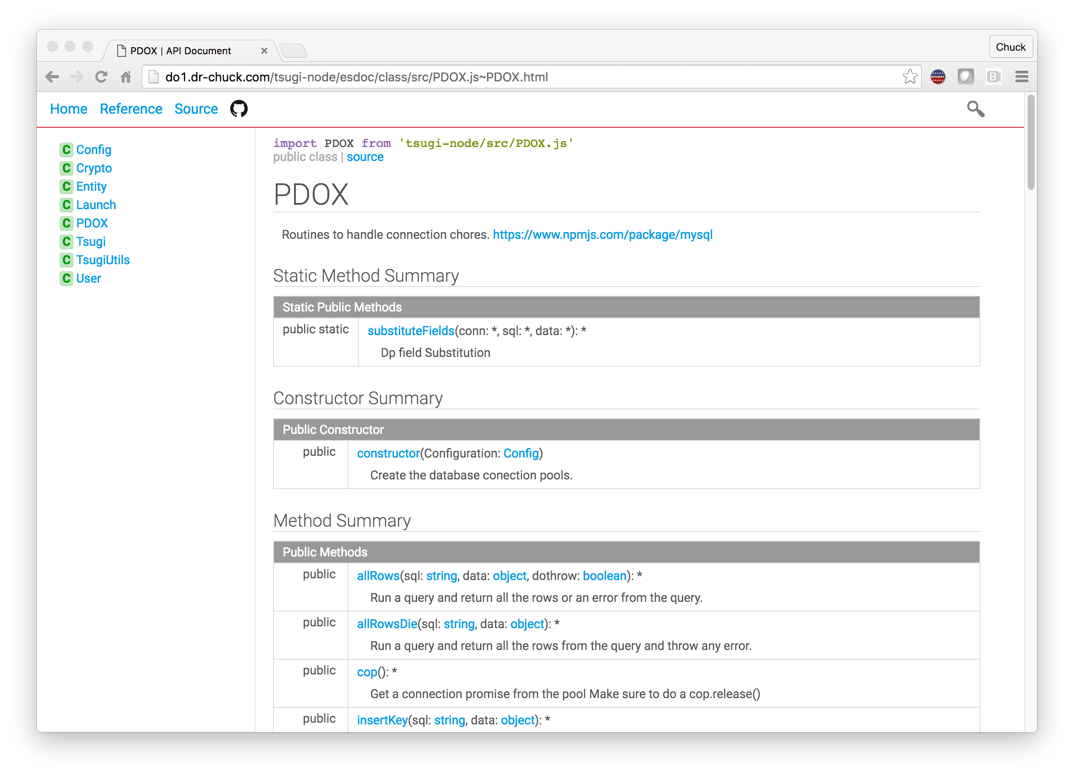

Slide 41
Summary
Tsugi PHP is very well developed
Production ready: LTI 1.1, ContentItem
Working: LTI 2.0, LTI 2.1, CASA
Tsugi Java – Might be folded into Sakai
Tsugi Node
Expecting a summer 2016 release for standalone pattern
https://groups.google.com/a/apereo.org/forum/#!forum/tsugi-dev

